Slide 1
MEDIATION: BASIC SKILLS TRAINING
Class Seven
Confidentiality and Neutrality
Barriers, Linking and Transmitting
Last Joint Sessions and Agreements
“We create positive change”

Slide 2
Goals...
Discuss the importance of confidentiality and neutrality.
Start to talk about ‘barriers to agreements.’
Think and talk about ways in which we might transmit information between the parties.
Think and talk about ways in which we might identify issue linkages with the parties.
Discuss agreements.
Work on the next step in the process - the last joint session.
“We create positive change”

Slide 3
Objectives...
Understand why confidentiality and neutrality help parties find solutions.
Define principles and explore their origins.
Identify the various ways that principles can appear in mediation.
Understand the consequences of principles.
Practice questions that will move parties past their principles.
Explain the value of transmitting in mediation.
Identify what information to transmit to parties and assess when to transmit to parties.
Work on our agreement writing skills.
Understand how to transmit to parties.
“We create positive change”

Slide 4
“Breathes there the mediator who does not shudder,
on hearing a negotiating party utter,
That pious oath,
with look invincible,
Here I stand,
‘It’s a matter of principle.’”
“We create positive change”
Notes:
Where is this quote from???? Also, we don’t need to use this, I just think it’s a cute example

Slide 5
Confidentiality is...
“Confidentiality” is defined as:
The state of keeping or being kept secret or private.
Confidentiality is vitally important in mediation because it facilitates disclosure.
People will not disclose personal needs, strategies, and information if they feel it might be used against them.
“We create positive change”
Notes:
https://scholarship.law.missouri.edu/cgi/viewcontent.cgi?referer=https://www.google.com/&httpsredir=1&article=1223&context=jdr

Slide 6
Mediation and Confidentiality…
Confidentiality is a critical component in
Definition
Principles
Introduction
Private meetings
Ethical standards
“We create positive change”

Slide 7
The Definition of Mediation…
Remember that:
Mediation is a voluntary, confidential and informal dispute resolution process in which a neutral with no power to impose a resolution, helps the parties try to reach a mutually acceptable settlement of their dispute.
Confidentiality is one of the reasons mediation works.
“We create positive change”
Notes:
The idea here is to broadly introduce the definition of mediation – taken from the Training manual

Slide 8
The Principles of Mediation…
Voluntary
Informed Consent
Confidential
Neutral
Self-Determination
“We create positive change”
Notes:
Making the point that confidentiality is an essential part of the mediation process. Participants should be aware of these prinicipals from Unit 1 - Robin

Slide 9
Confidentiality in the Mediation Process – Introduction…
Before you start
Voluntary
Confidential
Notes
“We create positive change”

Slide 10
Confidentiality in the Mediation Process – Private Sessions…
We repeat to each party all mediations are confidential during the start of the private sessions.
Welcome Back
Remind
Ask
Continue to remind
“We create positive change”

Slide 11
Now for Neutrality…
Someone who is neutral is…
Impartial third party.
In fact and appearance.
“We create positive change”
Notes:
Insert picture/comic/photo about neutrality

Slide 12
Neutrality in Mediation
In its most generalized form, neutrality may be defined as the absence of any bias in relation to either disputing party, and the mediator’s utilization of his position to appropriately balance the distribution of power between the parties (Cobb & Rifkin: 1991: 41-42).
Neutrality may also be defined by reference to what it achieves – most prominently fairness. This essentially means that it is the duty of the mediator to exclude any personal opinions and beliefs from the mediation process. In exercising neutrality, the mediator must aid the parties in arriving at – through self-determination - a mutual agreement (Spencer & Brogan, 2006: 92).
Neutrality in this respect can be defined as impartial assistance.
Notes:
I don’t know what to do with this wall of text???????

Slide 13
Neutrality in the Principles of Mediation…
Main principles of mediation
Voluntary
Informed Consent
Confidential
Mediators will always be a neutral third party
Self-Determination
“We create positive change”
Notes:
From page 2 of training manual. How is the concept of Neutral incorporated in the mediation practise

Slide 14
Neutrality in the Mediation Process – Introduction…
Before any mediation session
What’s important to you...
“As mediators, we don’t take sides, decide right or wrong, or give advice. You make all the decisions about what to do. If at any time you feel we are not being neutral, let us know, so you concerns can be addressed.
“We create positive change”

Slide 15
Defining ‘Principle’…
A comprehensive and fundamental law, doctrine, or assumption.
Attitudes and thoughts, an emotional state that block people from moving forward.
“We create positive change”

Slide 16
Origin of Principles…
Principles can be centered around many parts of life. However, most begin with these four areas:
Relationship:
Who are we to one another?
Personal Experience:
What has happened to me before in these situations?
Perception:
“This always happens to me” attitude.
Principles
History:
How have I/we handled this in the past?
“We create positive change”

Slide 17
The Language of Principle…
During a session, a mediator will hear:
“It’s not fair.”
“It’s not right.”
“I can’t do that, it’s the principle of the thing.”
“I have to stick to my principles.”
“We create positive change”

Slide 18
“I would rather be an opportunist and float than go to the bottom with my principles round my neck.”
- Stanley Baldwin
“We create positive change”

Slide 19
Types of Principles
Parties will apply a variety of principles to their situation:
Slippery Slope
“Really a Principle”
Anger
Negotiating Strategy
False Optimism
“We create positive change”

Slide 20
Slippery Slope…
Often invoked when someone is afraid that a few compromises will lead to continued concessions.
Slippery Slope
“We create positive change”

Slide 21
Anger…
Stay angry
Anger
“We create positive change”

Slide 22
False Optimism…
Stuck in the “I’m right” position
False Optimism
“We create positive change”

Slide 23
Negotiating Strategy…
A form of intimidation.
Negotiating Strategy
“We create positive change”

Slide 24
“Really a Principle”…
Ingrained belief system about right and wrong.
“Really a Principle”
“We create positive change”

Slide 25
Consequences of Principles…
These principles can lead to unwanted consequences in mediation such as,
Cyclical arguments and conversations
Failure to move forward with an agreement
As a result of no agreement, relationships get stuck
Patterns will be repeated
“We create positive change”

Slide 26
Questions for Getting Past the Principle…
Mediators can ask questions like these to move past hard principles brought in by the clients:
“Tell me what you mean by fair.”
“Is your anger the most important thing?”
“How committed are you to staying angry?””
“Of what value is that emotion in continuing the dispute?”
“What would it feel like to let go of being angry?”
“We create positive change”
Notes:
Some of these questions are quite aggressive???

Slide 27
Questions For Getting Past the Principle… (continued)
“What are the costs of following the principle?”
“Are there any options which might honor your principle and give rise to a resolution?”
“How important is being right?”
“I understand that is a matter of principle for you - what did you hope to gain from mediation?”
What are some questions that you might use?
“We create positive change”

Slide 28
Take a Moment to Revisit Basic Responses...
Reflecting:
The mediator repeats back what they believe the speaker has just said, using language similar the speaker's own.
Summarizing:
The mediator condenses what has been said, or what has happened into the essential points.
Questioning:
Done with open-ended questions that encourage reflection, collaboration, dialogue, and deliberation.
Checking in:
How the mediator makes the process transparent and empowers the parties by asking whether a decision point that the mediator has noticed, is one that the parties wish to act upon.
“We create positive change”

Slide 29
Follow Up Questions…
Some questions to ask the parties after a pushing past principal:
What would you like to see happen? Can you picture that? What does that look like?
What do YOU want to do about it? What are YOU willing to do?
What would you like the other party to understand?
Is there anything you wish you did differently?
What would you like to see happen in this relationship going forward?
How will you feel if this is resolved?
What will work for you?
What are your options? Do we have all of your options? What other options might you try?
What do you need to be comfortable? What do you need to feel better? What do you need to put this behind you?
“We create positive change”
Notes:
Does this belong in questioning?

Slide 30
Defining “Transmitting”…
In mediation, as in other interpersonal communication, when and how you share thoughts, feelings and ideas is as important as the information itself.
The goal in mediation is for the neutral to transmit information in the way it can be best heard.
“We create positive change”

Slide 31
Transmitting in Mediation…
As mediators, we need to be skilled in our ability to transmit both “easy” and “hard” information to the parties.
“We create positive change”
Notes:
From Training book pg 8

Slide 32
What to Transmit in Mediation…
Feelings
Offers
Answers to parties’ questions
“We create positive change”
Notes:
From Training book pg 8

Slide 33
When to Transmit in Mediation…
Not TOO Soon!
After the person has calmed down.
When the party is ready to hear.
“We create positive change”
Notes:
From Training book pg 8

Slide 34
How to Transmit in Mediation…
Best hear it
With positives
Link, link, link
“We create positive change”
Notes:
From Training book pg 8

Slide 35
Linking as a Tool…
Statements issues and concerns that parties have in common
Sharing
Facts
Emotions
Positives
Issues/concerns
Agreements
Goals
“We create positive change”

Slide 36
When to Link…
First Joint Sessions
First Private Sessions
Later Private Sessions
Last Joint Session
“We create positive change”
Notes:
From Training book pg 10

Slide 37
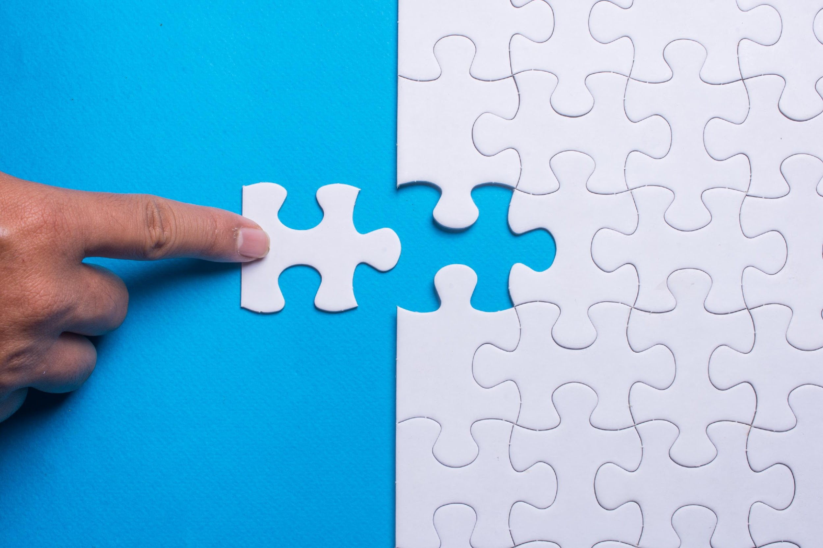
Think Link!
If you “Think Link!”, it is likely you will:
“We create positive change”
Notes:
From Training book pg 10. Maybe somewhere include an image for Think link

Slide 38
Think Link!
Identify more issues and concerns.
Ask more relevant questions.
Develop a better understanding of the big picture.
Listen for the little things that actually matter.
Create a climate where parties feel you’re working for them.
“We create positive change”
Notes:
From Training book pg 10. Maybe somewhere include an image for Think link

Slide 39
Understanding Agreements...
Let's review the principles of mediation:
Requires informed consent
Self-determination
Confidential
Informal
Neutral as to parties and subject matter
“We create positive change”

Slide 40
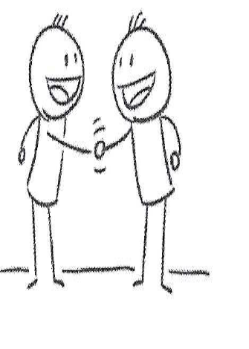
Understanding Agreements...
Parties have come to a consensus about a resolution for moving forward.
“We create positive change”

Slide 41
The Mediator's Role in Agreements
Don't prejudge
No stake
Focus
Process
Skills
What the parties want
“We create positive change”

Slide 42
Mediators Help Parties To...
Clarify
Narrow
Improve communication
Identify
Create Opportunities
Stick to the process
“We create positive change”

Slide 43
Barriers to Agreements...
Deadlocked
Don't panic or assume that an agreement is not going to happen.
“We create positive change”

Slide 44
Later Mediators' Breaks
Identify what information to transmit to the parties
How to package
When to transmit
Identify areas of agreements
Identify issues that still need to be resolved
Make a plan
Anticipate challenges
Anticipate barriers
Identify settlement strategies
Sort out who is doing what
“We create positive change”

Slide 45
Later Mediators' Breaks
Prepare to bring everyone back together
Determine how to set the stage
Review the points of agreement
Identify the impasses
Sort out who is doing what
“We create positive change”

Slide 46
Last Joint Session
Set the stage
Link shared thinking and feelings
Share positives and apologies
Review agreement points
Summarize where they are
Get specifics
Encourage them to talk to each other
“We create positive change”

Slide 47
Last Joint Session
Deal with impasse if necessary
Link shared thinking and feelings
Share positives and apologies
Summarize where they are
Discuss options
Look at consequences of no agreement
Ask them what they want to do
“We create positive change”

